Slide 1
Lecture 6: Hedonics, Voting with Your Feet, and Why it’s Not That Simple
Prof. Theising
Environmental Economics Econ 4075

Slide 2
The “Characteristics” Model
Lancaster (1966) – A New Approach to Consumer Theory
The good, per se, does not give utility to the consumer; it possesses characteristics, and these characteristics give rise to utility.

Slide 3
The “Characteristics” Model
Lancaster (1966) – A New Approach to Consumer Theory
The good, per se, does not give utility to the consumer; it possesses characteristics, and these characteristics give rise to utility.
In general, a good will possess more than one characteristic, and many characteristics will be shared by more than one good.

Slide 4
The “Characteristics” Model
Lancaster (1966) – A New Approach to Consumer Theory
The good, per se, does not give utility to the consumer; it possesses characteristics, and these characteristics give rise to utility.
In general, a good will possess more than one characteristic, and many characteristics will be shared by more than one good.
Goods in combination may possess characteristics different from those pertaining to the goods separately.
“A meal (treated as a single good) possesses nutritional characteristics, and different meals will possess these characteristics in different relative proportions. Furthermore, a dinner party, a combination of two goods, a meal and a social setting, may possess nutritional, aesthetic, and perhaps intellectual characteristics different from the combination obtainable from a meal and a social gathering consumed separately.”

Slide 5
Quality-differentiated market goods
A quality-differentiated good is one defined by its characteristics.
Examples?

Slide 6
Quality-differentiated market goods
A quality-differentiated good is one defined by its attributes.
Examples:
An automobile is defined by vehicle class, engine size, gas mileage, safety equipment,…
A US health insurance plan is defined by deductible, co-insurance, out-of-pocket-max, available doctors, quality of care metrics,…
A house is defined by its structural attributes, lot attributes, neighborhood, local environmental conditions,…
The modern availability of data means we know a lot about the environment, and a lot about real estate markets
Digitized property transaction databases
Detailed GIS information on land use
Spatial techniques for linking data from numerous sources

Slide 7
Quality-differentiated market goods
What if the level of environmental quality affects the market price of a private real estate transaction?
We generally accept in economics that all (known) things about a good will capitalize into its price.
And we (often but not always) know about local environmental quality.

Slide 8
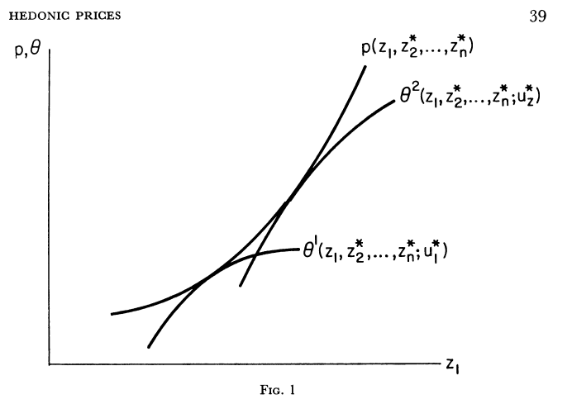
Hedonic Price Theory
Conceptual Model: Rosen (1974) –
Hedonic Prices and Implicit Markets, Product Differentiation in Pure Competition
Products are objectively measured in characteristics
Observed prices, combined with the set of characteristics, define a set of implicit or “hedonic” prices
This theory guides both producers and consumers in characteristics space

Slide 9
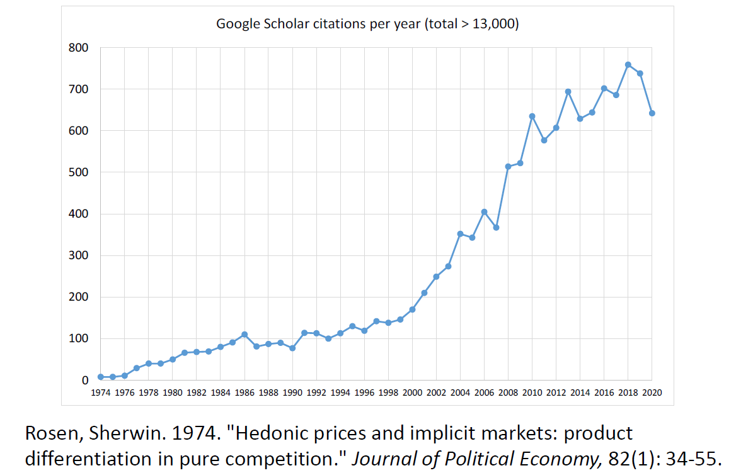
Enduring Popularity of Hedonic Property Models
Figure from N. Kuminoff.

Slide 10
Some intuition first, then the theory…
Imagine there are two identical lakes in western VA, each with 100 homes surrounding them.
All homes are lakefront, all the characteristics of the homes themselves, the land, and the neighborhoods are identical across all properties.
At current equilibrium price of $500,000/house, all 200 homes on either lake are equally preferred.

Slide 11
Hedonics intuition
Suppose the water quality on Lake A is improved; the water is clearer, which is beneficial to the residents who live on the lake.
If prices have not changed, consumers would now all prefer to buy Lake A homes. In econ-speak: at current prices, there would be excess demand for Lake A homes.
To bring the market back into equilibrium, we know that excess demand will be satisfied by Lake A prices increasing.

Slide 12
Hedonics intuition
The new equilibrium price difference between Lake A and Lake B homes is the implicit price that consumers are willing to pay for the improvement in water quality.
If Lake A homes now sell for $525,000, while Lake B homes have an unchanged price, the implicit price of the water quality improvement is $25,000.
WTP for water clarity is revealed to us through the homes’ market prices!
A question for you to check your understanding: could we have measured this implicit price before the improvement in Lake A’s water quality?
Another: how much more WTP in this market for an additional 1 unit of improvement?

Slide 13
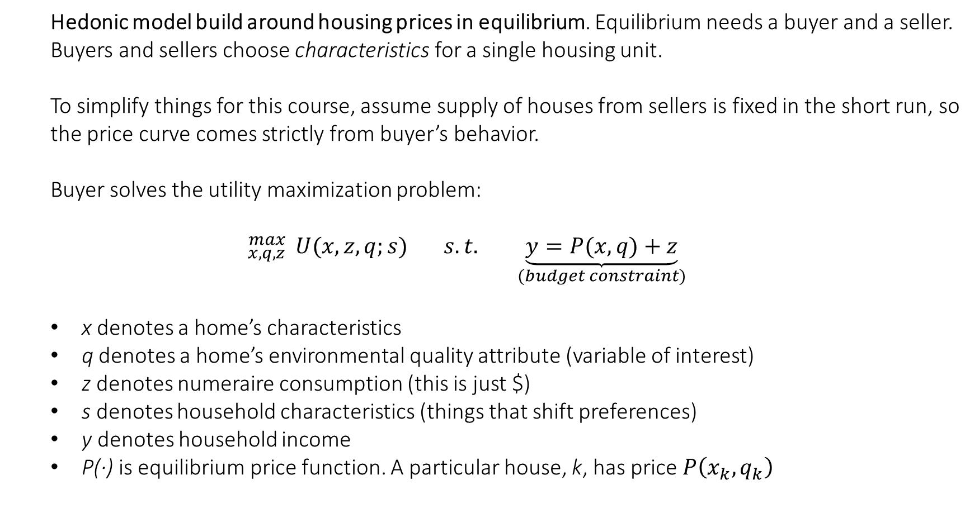
Hedonic Price Theory
Hedonic model build around housing prices in equilibrium. Equilibrium needs a buyer and a seller. Buyers and sellers choose characteristics for a single housing unit.
To simplify things for this course, assume supply of houses from sellers is fixed in the short run, so the price curve comes strictly from buyer’s behavior.
Buyer solves the utility maximization problem:
$${}_{x,q,z}^{max}{ U(x,z,q;s)} s.t. \underset{(budget constraint)}{\underbrace{y=P(x,q)+z}}$$
x denotes a home’s characteristics
q denotes a home’s environmental quality attribute (variable of interest)
z denotes numeraire consumption (this is just $)
s denotes household characteristics (things that shift preferences)
y denotes household income
P(∙) is equilibrium price function. A particular house, k, has price $P\left(x_{k},q_{k}\right)$

Slide 14
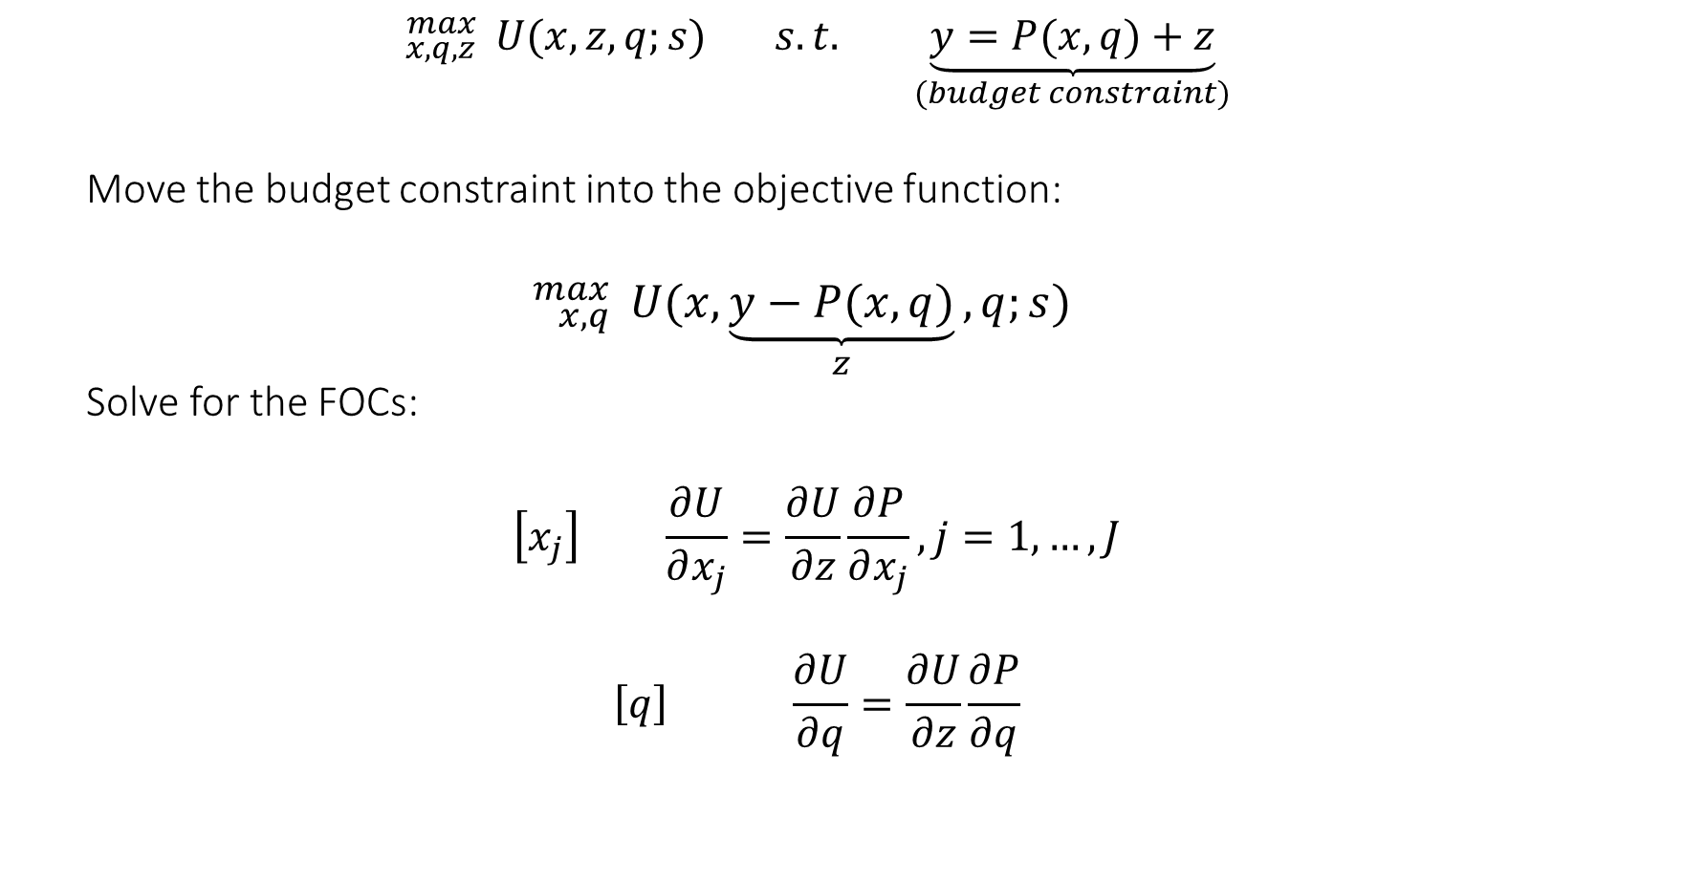
Solving buyer’s choice problem
$${}_{x,q,z}^{max}{ U(x,z,q;s)} s.t. \underset{(budget constraint)}{\underbrace{y=P(x,q)+z}}$$
Move the budget constraint into the objective function:
$${}_{x,q}^{max}{ U(x, \underset{z}{\underbrace{y−P(x,q)}},q;s)}$$
Solve for the FOCs:
$$\left[x_{j}\right] \frac{∂U}{∂x_{j}}=\frac{∂U}{∂z}\frac{∂P}{∂x_{j}}, j=1,…, J$$
$$\left[q\right] \frac{∂U}{∂q}=\frac{∂U}{∂z}\frac{∂P}{∂q}$$

Slide 15

Solving buyer’s choice problem
Rearranging:
$$\frac{∂P}{∂q} = \frac{\frac{∂U}{∂q}}{\frac{∂U}{∂z}}$$
What does this tell us?

Slide 16
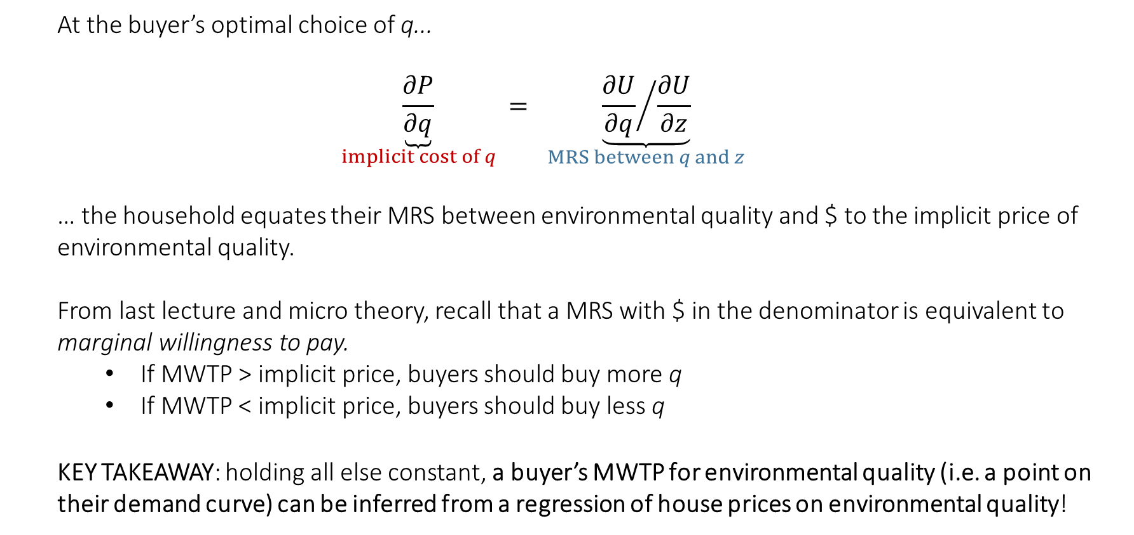
Solving buyer’s choice problem
At the buyer’s optimal choice of q...
$$\underset{implicit cost of q}{\underbrace{\frac{∂P}{∂q}}} = \underset{MRS between q and z}{\underbrace{{\frac{∂U}{∂q}}/{\frac{∂U}{∂z}}}}$$
… the household equates their MRS between environmental quality and $ to the implicit price of environmental quality.
From last lecture and micro theory, recall that a MRS with $ in the denominator is equivalent to marginal willingness to pay.
If MWTP > implicit price, buyers should buy more q
If MWTP < implicit price, buyers should buy less q
KEY TAKEAWAY: holding all else constant, a buyer’s MWTP for environmental quality (i.e. a point on their demand curve) can be inferred from a regression of house prices on environmental quality!

Slide 17
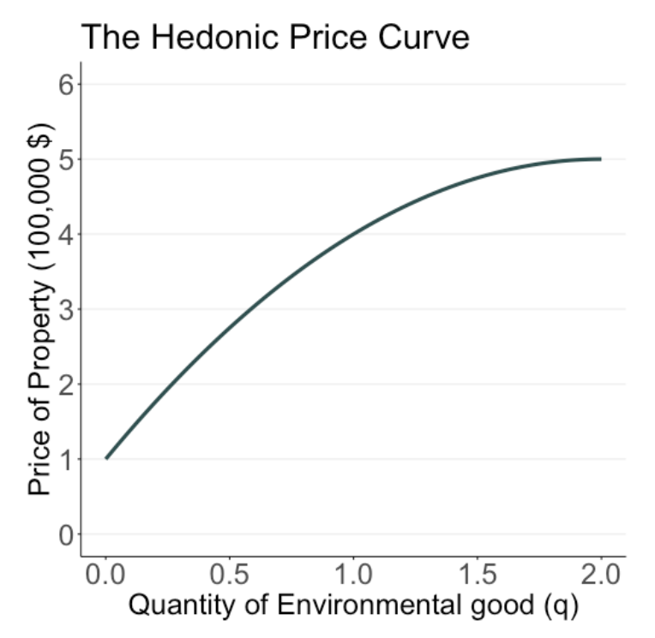
Using the price curve
Hedonic price curve: P(x, q). Go on Zillow and you can trace out something like this.
As shown here in (q, $) space, P(x, q)
is increasing in q. (Note we’re holding x constant in this figure!)
We typically assume buyers get decreasing marginal utility from additional unit of environmental quality
For example: let q be distance from coal-powered electricity generation facility.

Slide 18
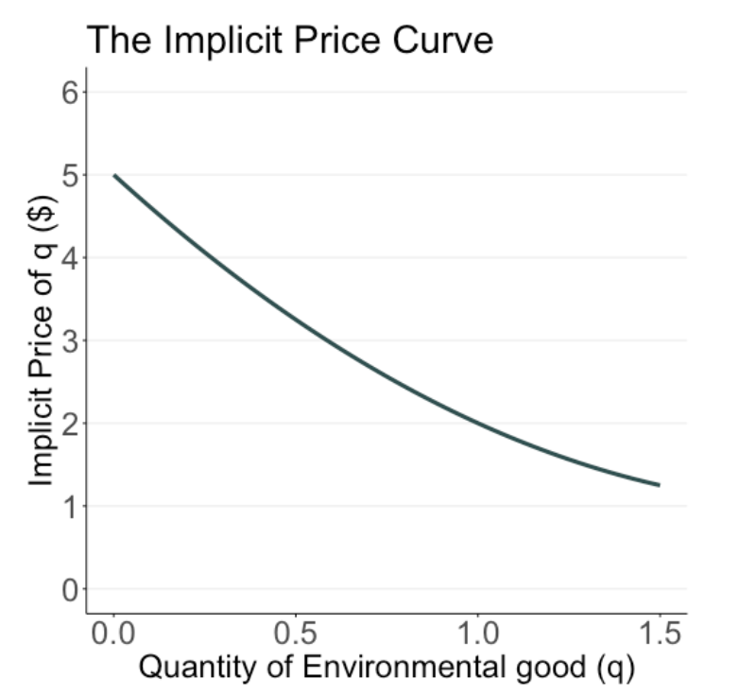
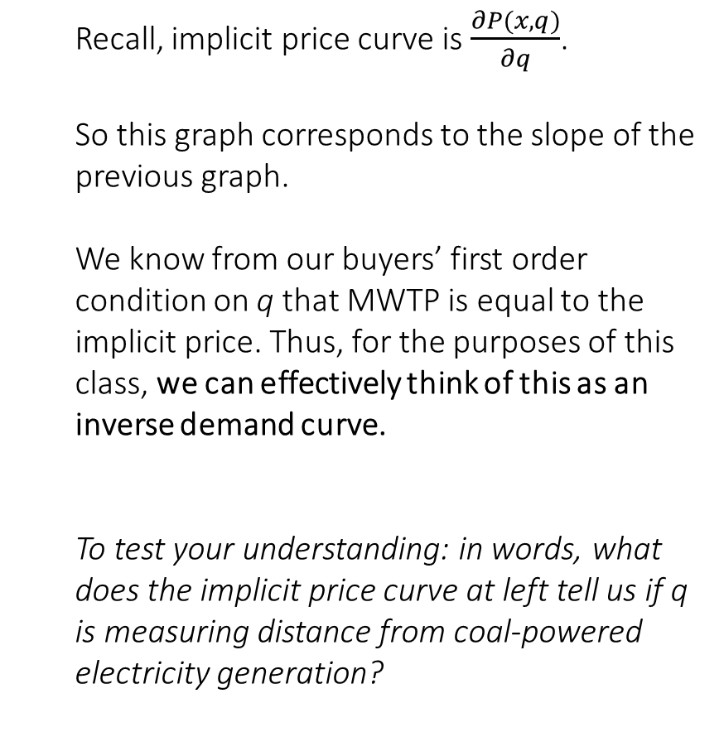
Implicit price curve
Recall, implicit price curve is $\frac{∂P(x,q)}{∂q}$.
So this graph corresponds to the slope of the previous graph.
We know from our buyers’ first order condition on q that MWTP is equal to the implicit price. Thus, for the purposes of this class, we can effectively think of this as an inverse demand curve.
To test your understanding: in words, what does the implicit price curve at left tell us if q is measuring distance from coal-powered electricity generation?

Slide 19
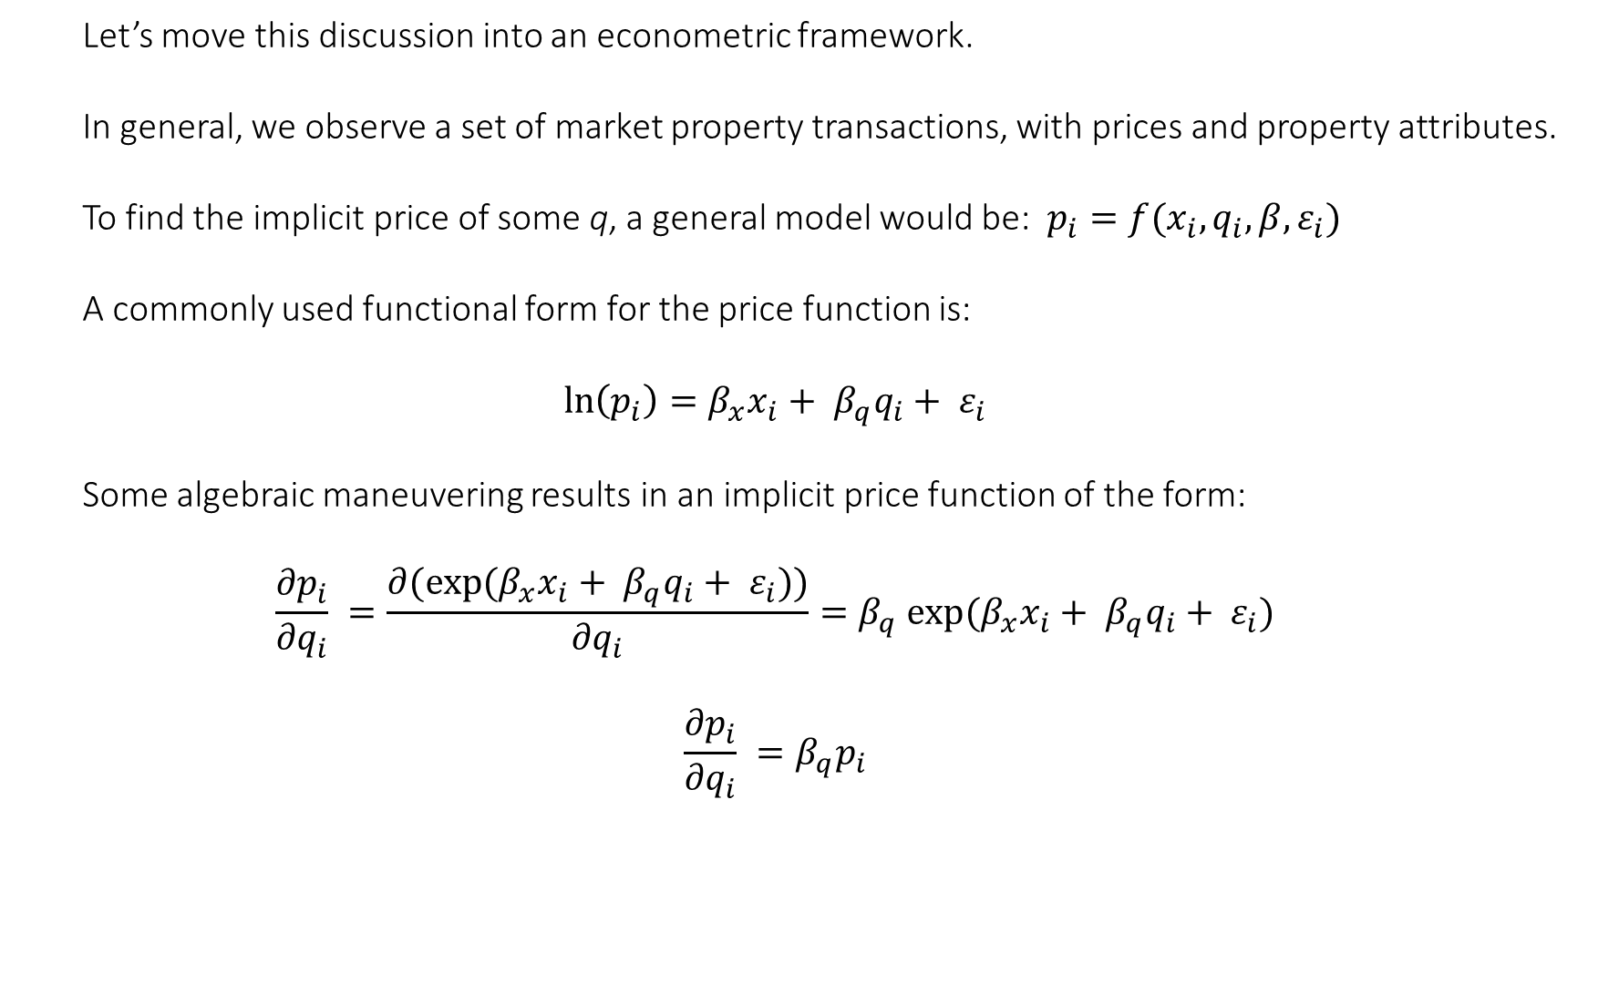
Estimating the implicit price curve
Let’s move this discussion into an econometric framework.
In general, we observe a set of market property transactions, with prices and property attributes.
To find the implicit price of some q, a general model would be:$p_{i}=f(x_{i},q_{i},β,ε_{i})$
A commonly used functional form for the price function is:
$$ln\left(p_{i}\right)=β_{x}x_{i}+ β_{q}q_{i}+ ε_{i}$$
Some algebraic maneuvering results in an implicit price function of the form:
$$\frac{{∂p}_{i}}{{∂q}_{i}} =\frac{∂({exp⁡(β}_{x}x_{i}+ β_{q}q_{i}+ ε_{i}))}{{∂q}_{i}}={β_{q} exp⁡(β}_{x}x_{i}+ β_{q}q_{i}+ ε_{i})$$
$$\frac{{∂p}_{i}}{{∂q}_{i}} =β_{q}p_{i}$$

Slide 20
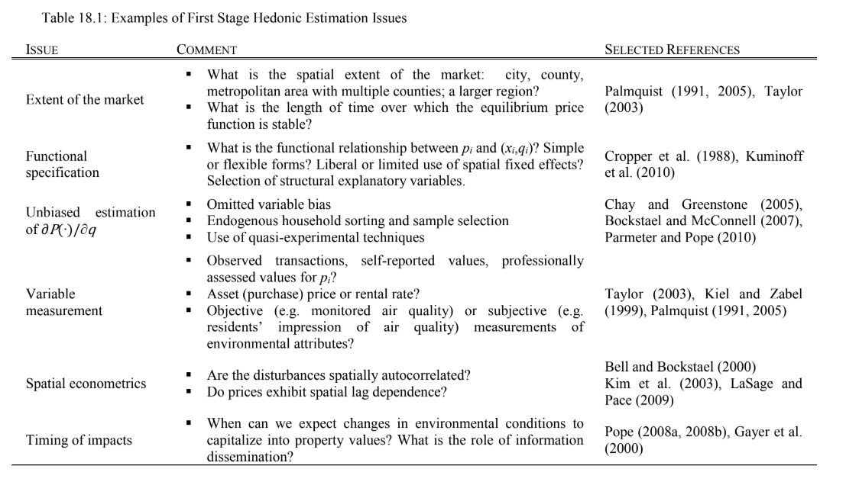
Estimating the implicit price curve
When estimating a hedonic model, analysts make necessary assumptions and decisions on several fronts.
Some examples:

Slide 21
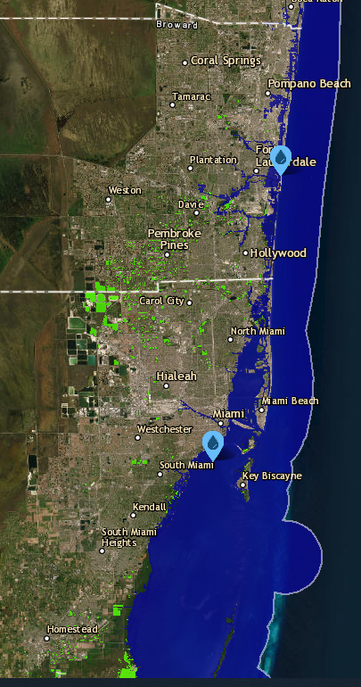
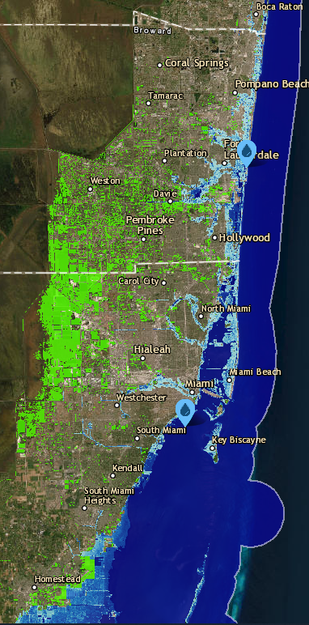
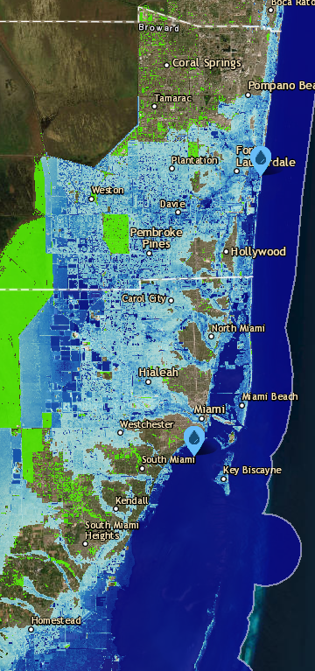
An Example: Sea Level Rise & Hedonics
Current levels
3 feet of SLR
6 feet of SLR

Slide 22
An Example: Sea Level Rise & Hedonics
Sea level rise is happening slowly today.
By end of century, however, optimistic projections are around 2 feet of rise along US coastlines.
Pessimistic projections: 7 feet of rise.
So while SLR should have little immediate physical impact on homebuyers today, can we detect positive homebuyer WTP for higher-lying properties along US coasts?
Do you think SLR has been capitalizing into housing prices over recent years?

Slide 23
An Example: Sea Level Rise & Hedonics
One can make an argument that SLR should feed into current prices:
Future owners of the home will face costs due to flooding/evacuation/inhabitability.
Therefore future buyers of the home may discount value of home.
Therefore current buyers will not be able to resell home for “full” value in future
Therefore current buyers are not willing to pay as much for home right now.
Nevertheless, the question we pose is an empirical question. Markets are not always efficient, and this is something that can be tested.

Slide 24
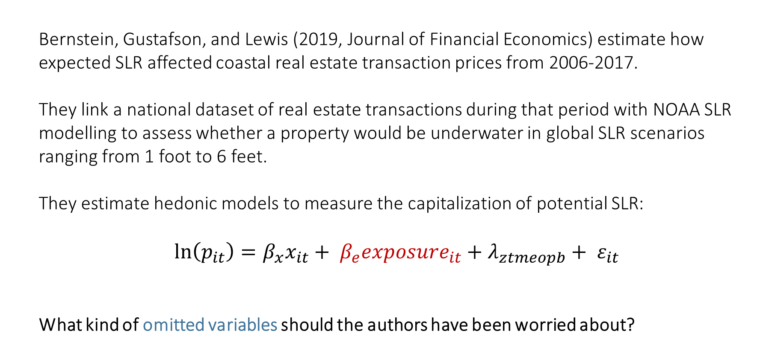
An Example: Sea Level Rise & Hedonics
Bernstein, Gustafson, and Lewis (2019, Journal of Financial Economics) estimate how expected SLR affected coastal real estate transaction prices from 2006-2017.
They link a national dataset of real estate transactions during that period with NOAA SLR modelling to assess whether a property would be underwater in global SLR scenarios ranging from 1 foot to 6 feet.
They estimate hedonic models to measure the capitalization of potential SLR:
$ln\left(p_{it}\right)=β_{x}x_{it}+ β_{e}{exposure}_{it}+λ_{ztmeopb}+ ε_{it}$
What kind of omitted variables should the authors have been worried about?

Slide 25
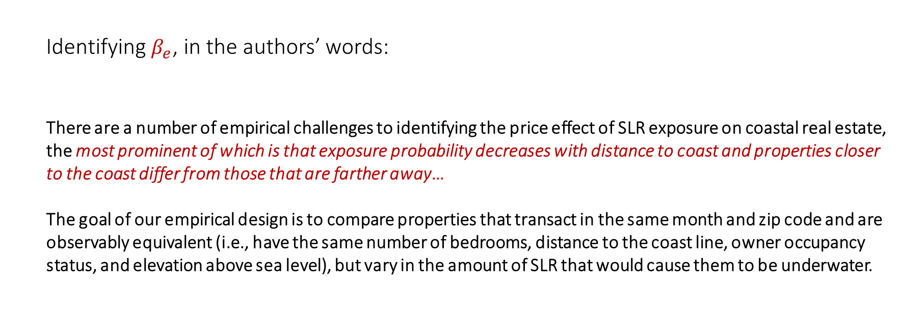
An Example: Sea Level Rise & Hedonics
Identifying $β_{e}$, in the authors’ words:
There are a number of empirical challenges to identifying the price effect of SLR exposure on coastal real estate, the most prominent of which is that exposure probability decreases with distance to coast and properties closer to the coast differ from those that are farther away…
The goal of our empirical design is to compare properties that transact in the same month and zip code and are observably equivalent (i.e., have the same number of bedrooms, distance to the coast line, owner occupancy status, and elevation above sea level), but vary in the amount of SLR that would cause them to be underwater.

Slide 26
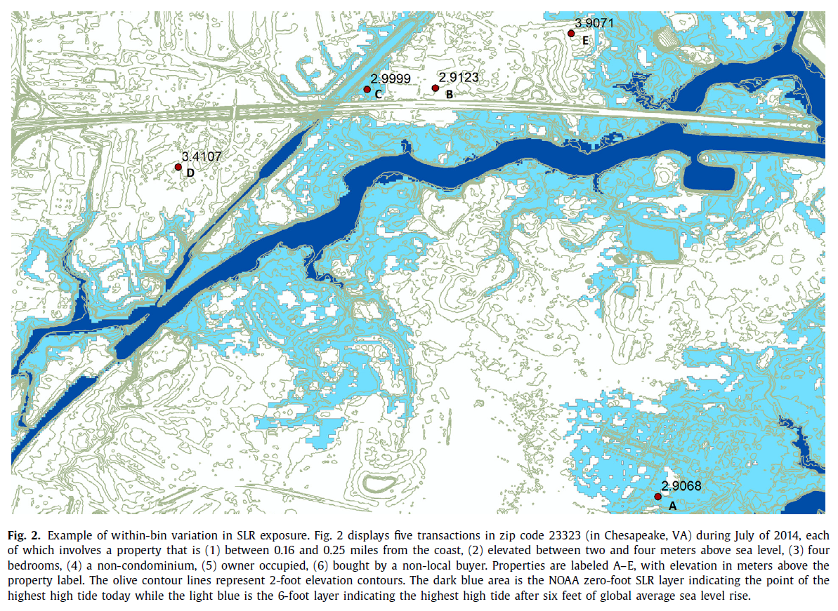
An Example: Sea Level Rise & Hedonics
The fixed effects in the main regression ensure price comparisons are made only between properties
In the same ZIP code
In the same month/year
In the same 2-meter elevation bin
With the same owner occupancy/out-of-town buyer status
In the same “distance to coast” bin (0.01,0.02,0.04,0.08,0.16,0.25 miles)
With the same # of bedrooms
With the same home type (SF/condo)
$ln\left(p_{it}\right)=β_{x}x_{it}+ β_{e}{exposure}_{it}+λ_{ztmeopb}+ ε_{it}$

Slide 27
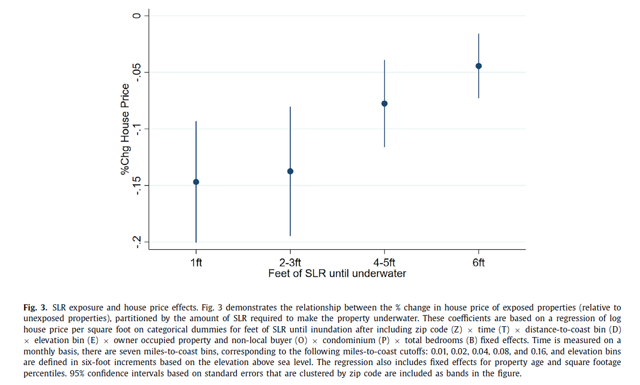
An Example: Sea Level Rise & Hedonics
Estimated effects:
Houses that would be under water with 1ft of SLR sell for 15% cheaper than the “comparison” house that is unexposed to SLR.
This effect tapers off for homes that are less exposed to SLR. Homes that would be underwater with 6ft of SLR sell for only 5% cheaper than an unexposed comparison.
In other results:
Using similar empirical design, SLR has no effect on rental price.
A dynamic estimation of SLR effect on sales price suggests the discount is growing over time as projections of SLR improve and buyers become informed.

Slide 28
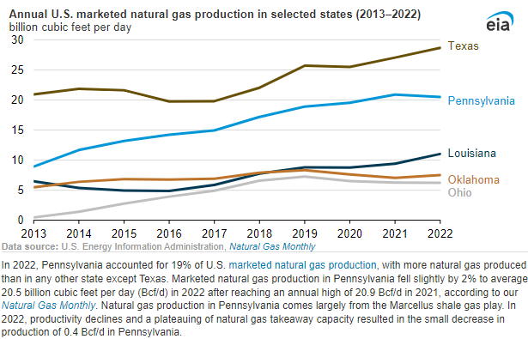
The Housing Market Impacts of Shale Gas Development Muehlenbachs et al. (2015, AER)
Research Context:
Marcellus shale gas play in PA is the second largest natural gas producer in the US.
Boom in production began in early-mid 2000s, continues to date.
Shale gas extraction is a classic natural resource story with winners and losers:
Locals with mining rights /employed in the energy sector benefit
US (and world) benefit from increased production/use of natural gas – it’s cleaner than coal/gasoline
Locals (maybe?) left with external costs of production, pollution and cleanup…
Mixed evidence: Here. Here. Here.

Slide 29
The Housing Market Impacts of Shale Gas Development Muehlenbachs et al. (2015, AER)
Research Question: What are the property value impacts of shale gas development?

Slide 30
The Housing Market Impacts of Shale Gas Development Muehlenbachs et al. (2015, AER)
Research Question: What are the (heterogeneous) property value impacts of shale gas development?
“Our results demonstrate that groundwater-dependent homes are, in fact, negatively affected by nearby shale gas development, indicating that the oft-debated risk to groundwater contamination has indeed materialized into a real impact. Similarly proximate homes that have access to publicly supplied piped water, on the other hand, appear to receive small benefits from that development. However, that benefit only comes from producing wells, suggesting that it reflects royalty payments to the homeowner from natural gas production. Recently drilled wells (i.e., drilled within the past year) do not contribute to this benefit, providing evidence that the drilling and hydraulic fracturing stages of shale gas development are the most disruptive. The burden of aesthetic disruptions is corroborated by the finding that the positive impacts are only driven by wells that are not in view of the property.”

Slide 31
The Housing Market Impacts of Shale Gas Development Muehlenbachs et al. (2015, AER)
Data:
Property transaction data for 36 Pennsylvania counties between 1995 and 2012.
Location and drill date for 6,260 wellbores
GIS boundaries of public water service areas
With 1 + 2: for each property transaction, calculate counts of the number wellpads drilled, within distance of {1,1.5,2km} by the date of the sale.
With 1 + 3: for each property transaction, create indicator variable for whether drinking water in home is from PWSA or a groundwater well.

Slide 32
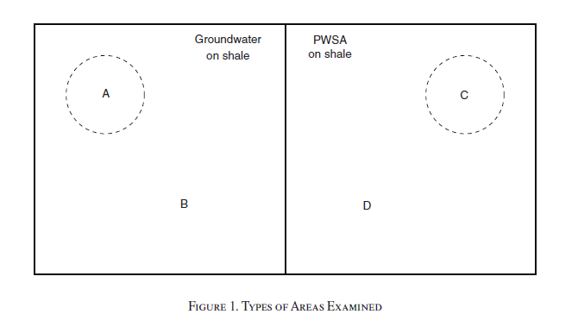
The Housing Market Impacts of Shale Gas Development Muehlenbachs et al. (2015, AER)
Research Design

Slide 33
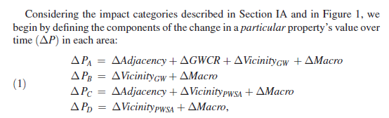
The Housing Market Impacts of Shale Gas Development Muehlenbachs et al. (2015, AER)
Research Design

Slide 34
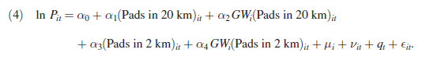
The Housing Market Impacts of Shale Gas Development Muehlenbachs et al. (2015, AER)
Research Design

Slide 35
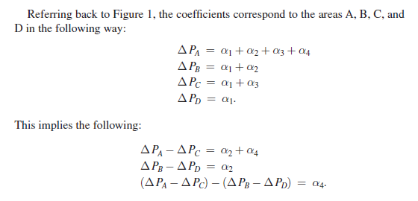
The Housing Market Impacts of Shale Gas Development Muehlenbachs et al. (2015, AER)
Research Design

Slide 36
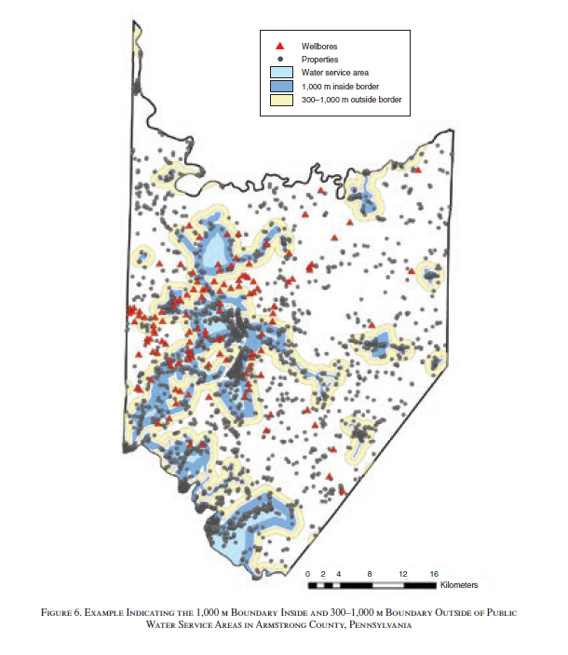
The Housing Market Impacts of Shale Gas Development Muehlenbachs et al. (2015, AER)
Research Design
Omitted variable bias?

Slide 37
The Housing Market Impacts of Shale Gas Development Muehlenbachs et al. (2015, AER)
Research Design
“Rural groundwater-dependent neighborhoods may be different in unobservable but important ways when compared with more urban PWSA neighborhoods, and these differences might vary over time.”

Slide 38
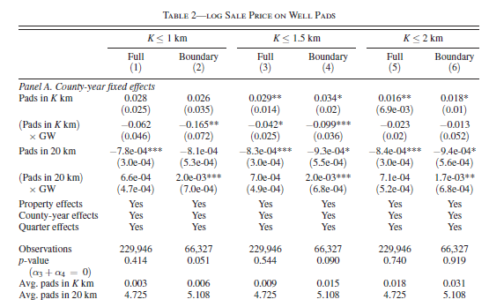
The Housing Market Impacts of Shale Gas Development Muehlenbachs et al. (2015, AER)

Slide 39
The Housing Market Impacts of Shale Gas Development Muehlenbachs et al. (2015, AER)
In summary:
The costs of shale gas groundwater contamination risk, as proxied by the drilling and operation of an additional wellpad, range from -9.9% to -16.5% of a home’s value.
Netting out adjacency impacts (from royalties, etc.), average loss to groundwater-dependent homes within 1.5km of a well was ~$30,000.
Average gain in value for homes with PWS and within 1.5km of a well was ~$5,000.
These estimates are a lower bound – do not account for defensive behaviors* like installation costs of water filters, or using bottled water.
Other points to discuss?

Slide 40
What are the limits and challenges associated with hedonic approaches to measuring nonmarket value?
Hedonic model assumes consumers can select from continuum of (x, q) values. Realistic?
My description of ideal DC home, price be damned, to RE agent: “On Capitol Hill in a smaller rowhouse, quiet street, with a BIG and private yard.” (His response: “LOL. That doesn’t exist.”)
Economists have tools to try and work around this. Take grad level metrics.
Household’s implied prices, as measured econometrically, are based on real-world amenity levels.
In reality, buyer’s beliefs are heterogeneous and based on perception/available information. Beliefs may be correlated with reality, or not; based on current amenity levels, or past/future levels. Hedonic analysis can accommodate for distortion between belief/reality, with clever econometrics.
Households are mobile and can choose the level of a public good (q) as they desire.
Increasing body of work suggesting frictions in mobility. These frictions are often correlated with local amenity levels…

Slide 41
The Damages and Distortions from Discrimination in the Rental Housing Market
Christensen and Timmins (forthcoming, QJE)
By constraining an individual's choice during a search, housing discrimination distorts sorting decisions away from true preferences and results in a ceteris paribus reduction in welfare. This study combines a large-scale field experiment with a residential sorting model to derive utility-theoretic measures of renter welfare loss associated with the constraints imposed by discrimination in the rental housing market. Results from experiments conducted in five cities show that key neighborhood amenities are associated with higher levels of discrimination. Counterfactual simulations based on the sorting model suggest that discrimination imposes damages equivalent to 4.4% and 3.5% of the annual incomes for African American and Hispanic/ LatinX renters, respectively. Damages are increasing in income for African American renters, such that impacts become stronger for economically mobile households. Renters of color must make substantial investments in additional search to mitigate the costs of these constraints. We find that a naive model ignoring discrimination constraints yields biased estimates of willingness to pay for key neighborhood amenities.

Slide 42
The Damages and Distortions from Discrimination in the Rental Housing Market
Christensen and Timmins (forthcoming, QJE)
By constraining an individual's choice during a search, housing discrimination distorts sorting decisions away from true preferences and results in a ceteris paribus reduction in welfare. This study combines a large-scale field experiment with a residential sorting model to derive utility-theoretic measures of renter welfare loss associated with the constraints imposed by discrimination in the rental housing market. Results from experiments conducted in five cities show that key neighborhood amenities are associated with higher levels of discrimination. Counterfactual simulations based on the sorting model suggest that discrimination imposes damages equivalent to 4.4% and 3.5% of the annual incomes for African American and Hispanic/ LatinX renters, respectively. Damages are increasing in income for African American renters, such that impacts become stronger for economically mobile households. Renters of color must make substantial investments in additional search to mitigate the costs of these constraints. We find that a naive model ignoring discrimination constraints yields biased estimates of willingness to pay for key neighborhood amenities.

Slide 43
The Damages and Distortions from Discrimination in the Rental Housing Market
Christensen and Timmins (forthcoming, QJE)
By constraining an individual's choice during a search, housing discrimination distorts sorting decisions away from true preferences and results in a ceteris paribus reduction in welfare. This study combines a large-scale field experiment with a residential sorting model to derive utility-theoretic measures of renter welfare loss associated with the constraints imposed by discrimination in the rental housing market. Results from experiments conducted in five cities show that key neighborhood amenities are associated with higher levels of discrimination. Counterfactual simulations based on the sorting model suggest that discrimination imposes damages equivalent to 4.4% and 3.5% of the annual incomes for African American and Hispanic/ LatinX renters, respectively. Damages are increasing in income for African American renters, such that impacts become stronger for economically mobile households. Renters of color must make substantial investments in additional search to mitigate the costs of these constraints. We find that a naive model ignoring discrimination constraints yields biased estimates of willingness to pay for key neighborhood amenities.

Slide 44
The Damages and Distortions from Discrimination in the Rental Housing Market
Christensen and Timmins (forthcoming, QJE)
By constraining an individual's choice during a search, housing discrimination distorts sorting decisions away from true preferences and results in a ceteris paribus reduction in welfare. This study combines a large-scale field experiment with a residential sorting model to derive utility-theoretic measures of renter welfare loss associated with the constraints imposed by discrimination in the rental housing market. Results from experiments conducted in five cities show that key neighborhood amenities are associated with higher levels of discrimination. Counterfactual simulations based on the sorting model suggest that discrimination imposes damages equivalent to 4.4% and 3.5% of the annual incomes for African American and Hispanic/ LatinX renters, respectively. Damages are increasing in income for African American renters, such that impacts become stronger for economically mobile households. Renters of color must make substantial investments in additional search to mitigate the costs of these constraints. We find that a naive model ignoring discrimination constraints yields biased estimates of willingness to pay for key neighborhood amenities.

Slide 45
The Damages and Distortions from Discrimination in the Rental Housing Market
Christensen and Timmins (forthcoming, QJE)
By constraining an individual's choice during a search, housing discrimination distorts sorting decisions away from true preferences and results in a ceteris paribus reduction in welfare. This study combines a large-scale field experiment with a residential sorting model to derive utility-theoretic measures of renter welfare loss associated with the constraints imposed by discrimination in the rental housing market. Results from experiments conducted in five cities show that key neighborhood amenities are associated with higher levels of discrimination. Counterfactual simulations based on the sorting model suggest that discrimination imposes damages equivalent to 4.4% and 3.5% of the annual incomes for African American and Hispanic/ LatinX renters, respectively. Damages are increasing in income for African American renters, such that impacts become stronger for economically mobile households. Renters of color must make substantial investments in additional search to mitigate the costs of these constraints. We find that a naive model ignoring discrimination constraints yields biased estimates of willingness to pay for key neighborhood amenities.

Slide 46
The Damages and Distortions from Discrimination in the Rental Housing Market
Christensen and Timmins (forthcoming, QJE)
By constraining an individual's choice during a search, housing discrimination distorts sorting decisions away from true preferences and results in a ceteris paribus reduction in welfare. This study combines a large-scale field experiment with a residential sorting model to derive utility-theoretic measures of renter welfare loss associated with the constraints imposed by discrimination in the rental housing market. Results from experiments conducted in five cities show that key neighborhood amenities are associated with higher levels of discrimination. Counterfactual simulations based on the sorting model suggest that discrimination imposes damages equivalent to 4.4% and 3.5% of the annual incomes for African American and Hispanic/ LatinX renters, respectively. Damages are increasing in income for African American renters, such that impacts become stronger for economically mobile households. Renters of color must make substantial investments in additional search to mitigate the costs of these constraints. We find that a naive model ignoring discrimination constraints yields biased estimates of willingness to pay for key neighborhood amenities.

Slide 47
Next class
Using Expenditures and Wages to Estimate Environmental Benefits:
Defensive behaviors + the VSL.
Wrenn et al (2016) is assigned reading.
Optional: Shogren and Stamland (2005).
Reminder, Case Study #1 due Sep 17 @ 11:59pm.

Slide 48
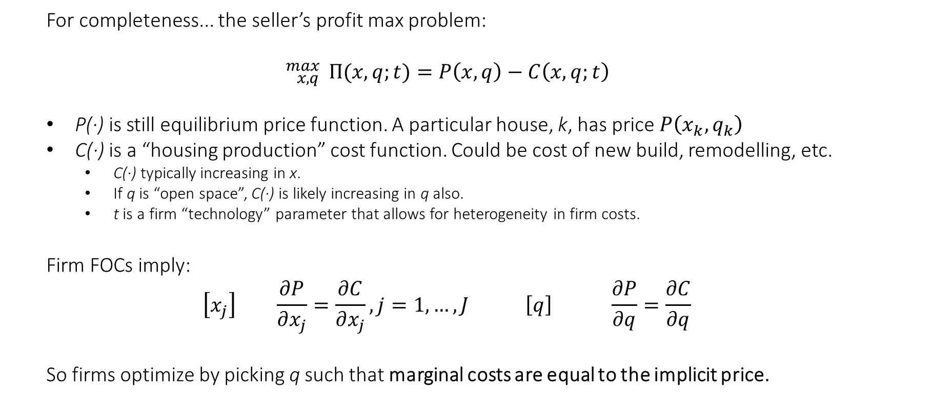
Appendix: Solving seller’s choice problem
For completeness... the seller’s profit max problem:
$${}_{x,q}^{max}{ Π(x,q;t)}=P\left(x,q\right)−C\left(x,q;t\right)$$
P(∙) is still equilibrium price function. A particular house, k, has price $P\left(x_{k},q_{k}\right)$
C(∙) is a “housing production” cost function. Could be cost of new build, remodelling, etc.
C(∙) typically increasing in x.
If q is “open space”, C(∙) is likely increasing in q also.
t is a firm “technology” parameter that allows for heterogeneity in firm costs.
Firm FOCs imply:
$$\left[x_{j}\right] \frac{∂P}{∂x_{j}}=\frac{∂C}{∂x_{j}}, j=1,…, J \left[q\right] \frac{∂P}{∂q}=\frac{∂C}{∂q}$$
So firms optimize by picking q such that marginal costs are equal to the implicit price.

Slide 49
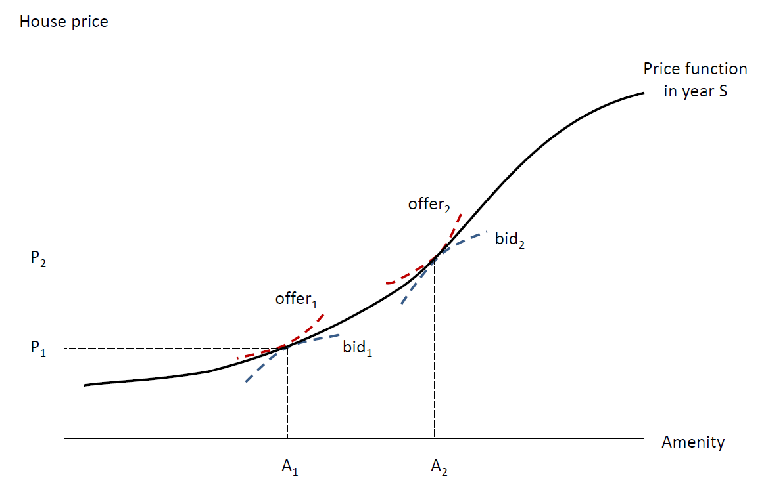
Appendix: Tracing out the price curve
Sellers and buyers meet in the market. Buyers have bid curves; sellers have offer curves. These are essentially indifference curves (holding all but q and $ fixed).
Where bid curves and offer curves are tangent, an exchange happens. The curve tracing out all these exchanges/tangencies is the price curve.
We observe this curve using transaction prices!

